Slide 1
Applied Data Science DATa visualization
Dr. Omri Allouche
2017

Slide 2
Homework – April 19
Submit solutions to the 2 notebooks under “Python Review”
Read Example Machine Learning Notebook until Step 5 (Classification) – not including
Read Visualization with Seaborn

Slide 3
Homework – April 26
[Apr 26] Perform EDA of the OkCupid dataset https://github.com/rudeboybert/JSE_OkCupid
Use Jupyter Notebook, combining markdown, code and graphs
Use appropriate headings and sections
Choose the best graph for the job
Explain what the graph shows
Submit notebook as a Pull Request. Name the file YOURID_YOURNAME_EDA_OkCupid.ipynb

Slide 4
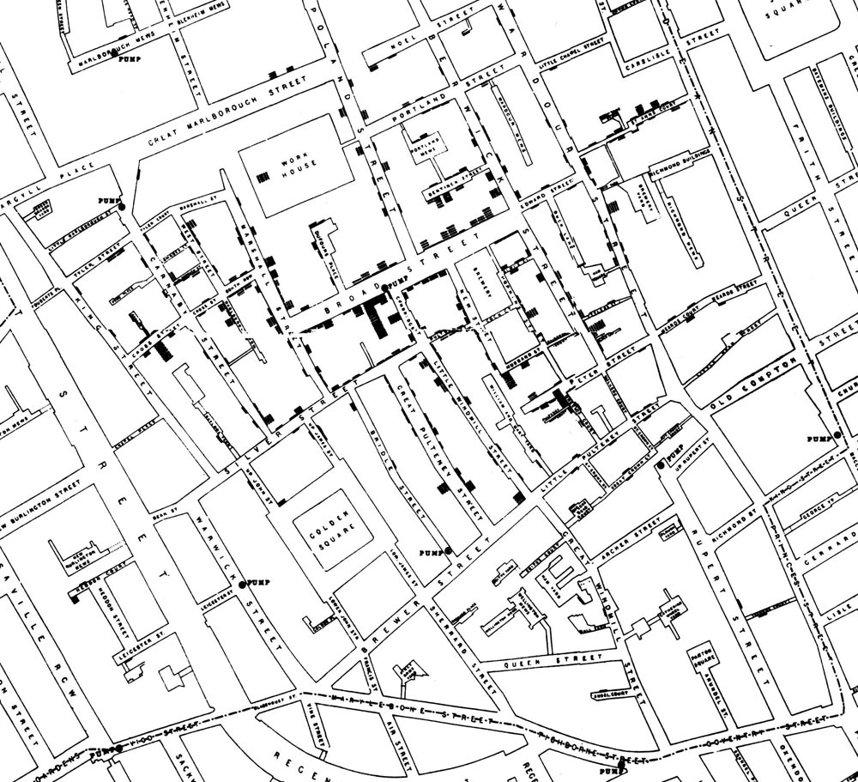
John Snow & The 1854 London Cholera Outbreak

Slide 5
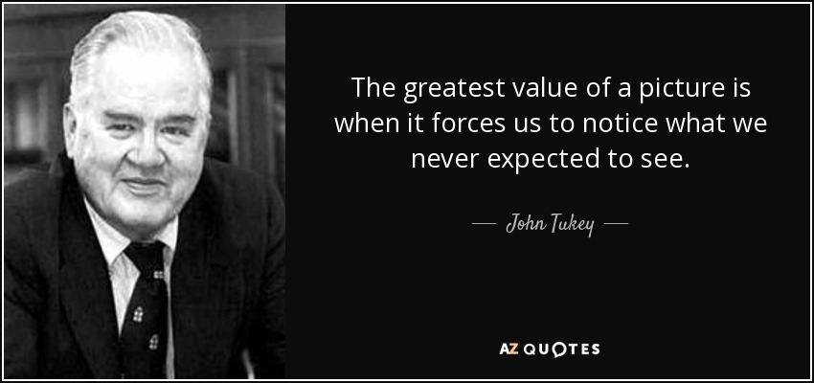

Slide 6
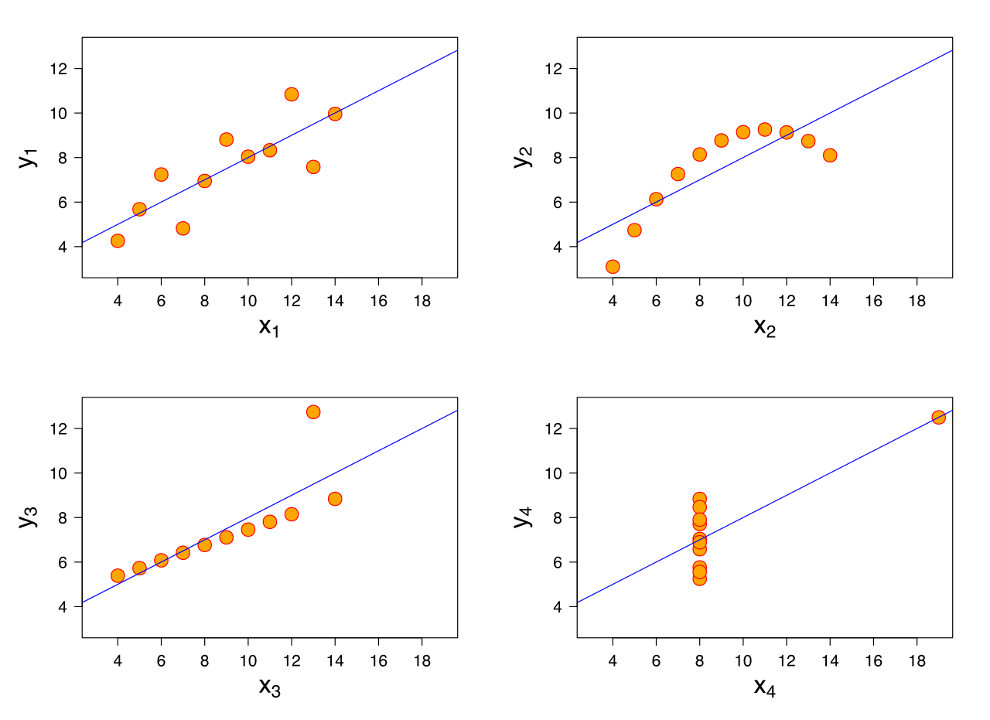
anscombe’s quartet

Slide 7
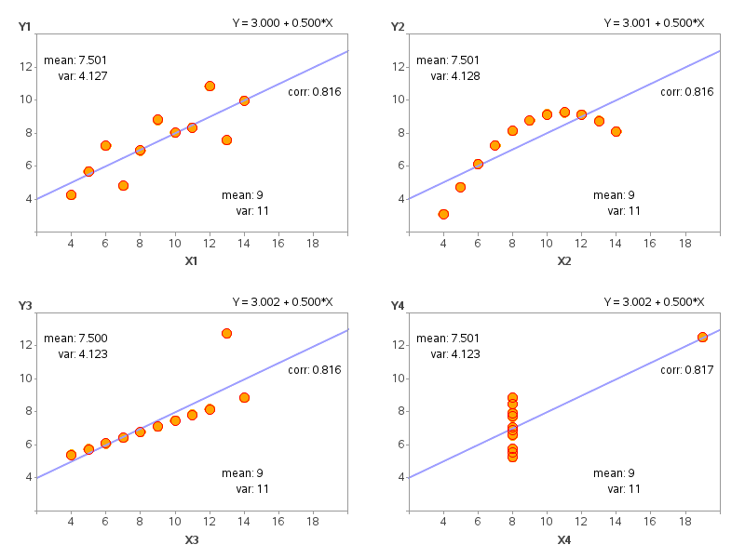
anscombe’s quartet

Slide 8
Data visualization – matplotlib
Review in class of a Jupyter Notebook.

Slide 9
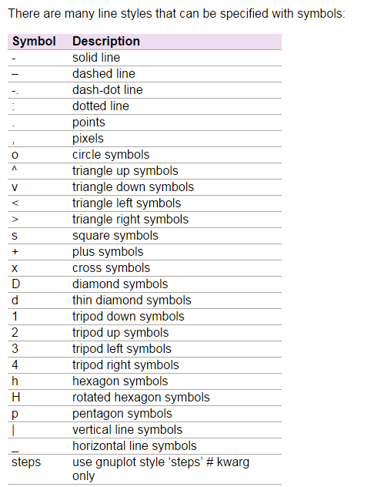
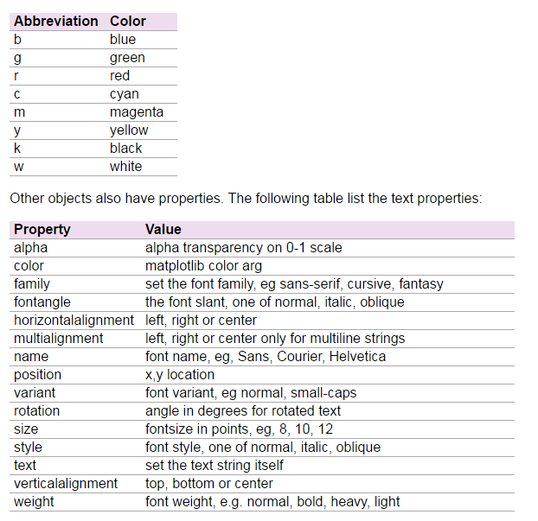

Slide 10
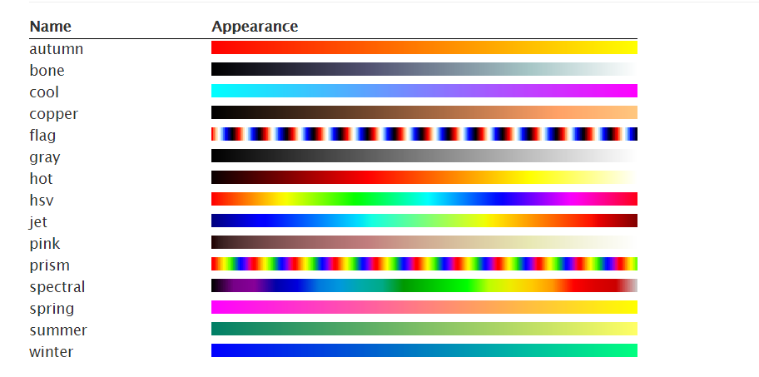
Colormaps
Source: http://www.labri.fr/perso/nrougier/teaching/matplotlib/

Slide 11
additional resource
A very in-depth introduction to Matplotlib:
http://nbviewer.jupyter.org/github/jakevdp/PythonDataScienceHandbook/blob/master/notebooks/04.00-Introduction-To-Matplotlib.ipynb

Slide 12
Univariate Distribution

Slide 13
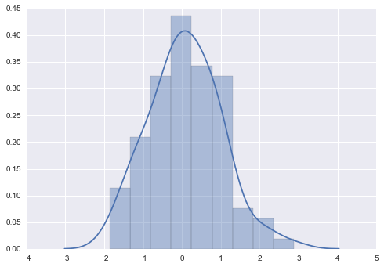
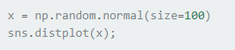
histogram

Slide 14
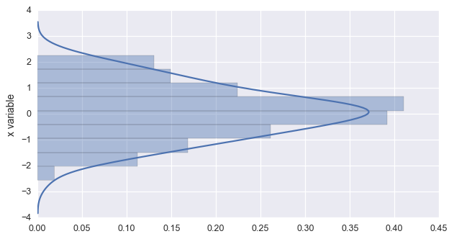
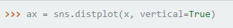
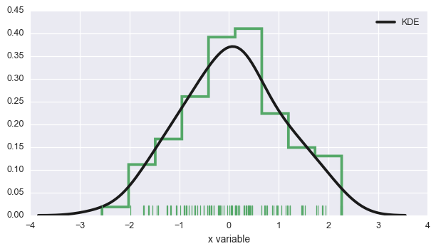
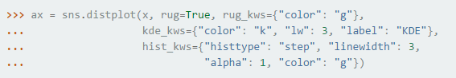
Histogram

Slide 15
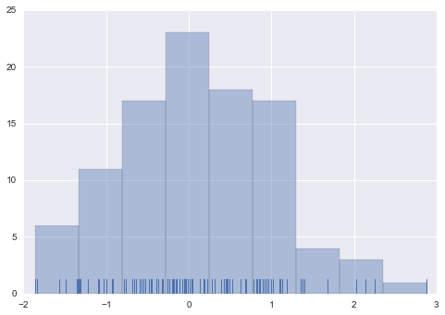
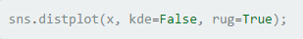
rugplot

Slide 16
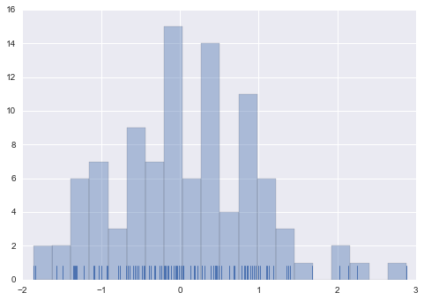
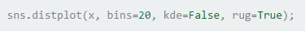
change # of Bins

Slide 17
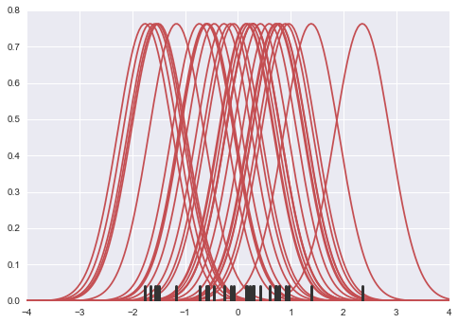
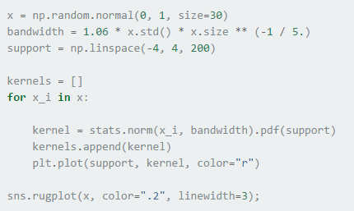
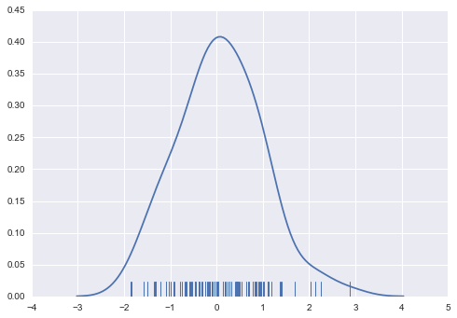
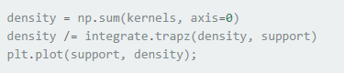
KDE – Kernel Density Estimation

Slide 18
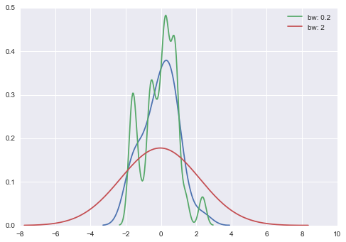
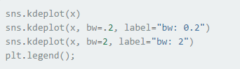
KDE – Change BW

Slide 19
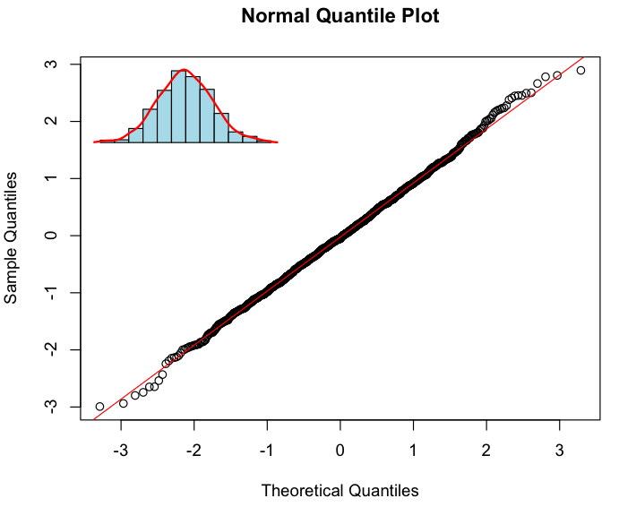
QQ Plot

Slide 20
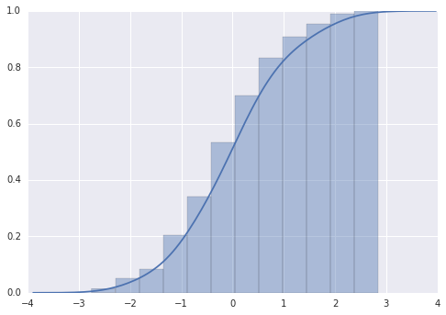
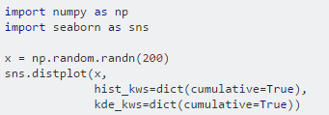
CDF – Cumulative Distribution Function

Slide 21
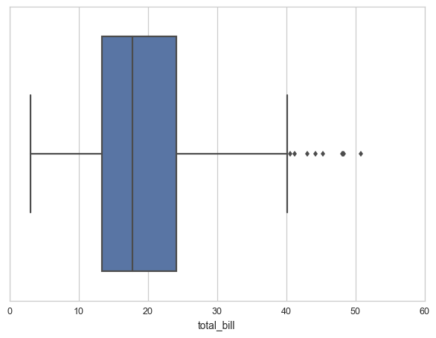
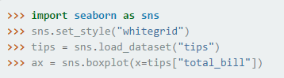
Boxplot
25%
Median
75%
Max OR 150% of IQR
Outliers

Slide 22
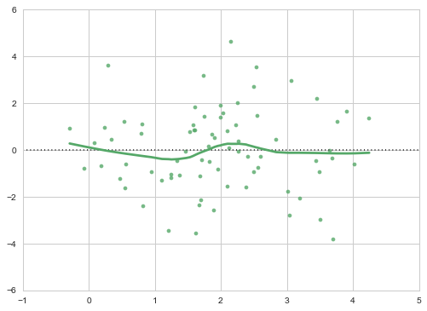
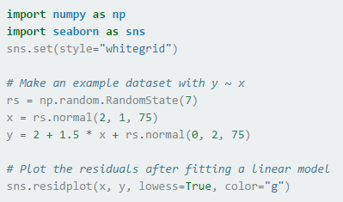
residplot - Residuals

Slide 23
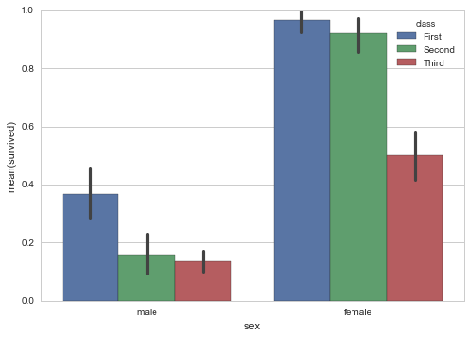
Bar plot

Slide 24
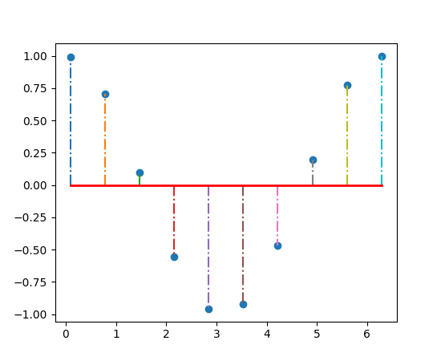
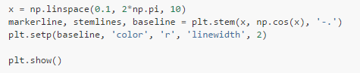
Stem & Leaf

Slide 25
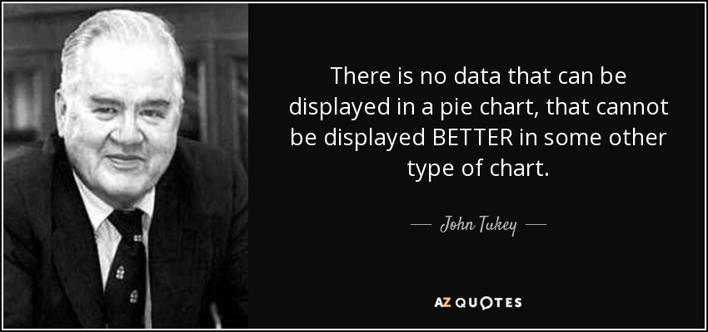
Pie Chart

Slide 26
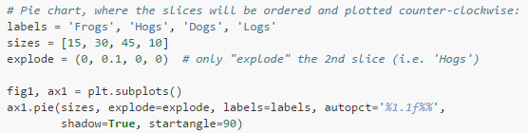
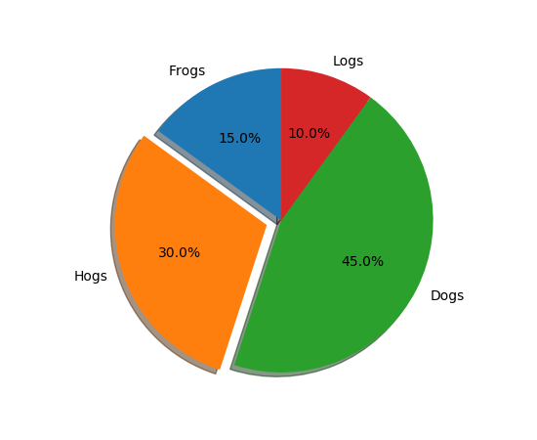
Pie Chart

Slide 27
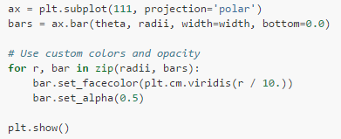
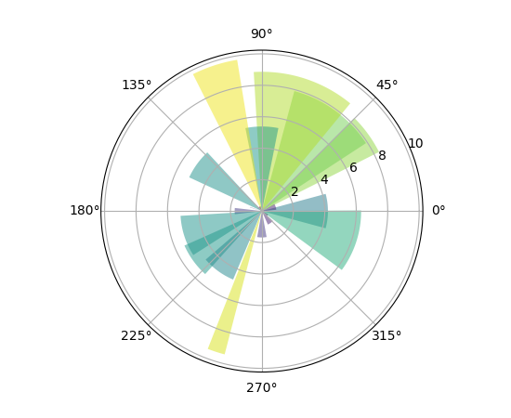
Polar Chart

Slide 28
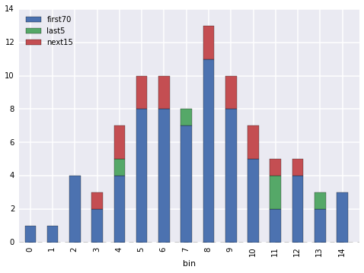
Stacked Bar Plot

Slide 29
Regression

Slide 30
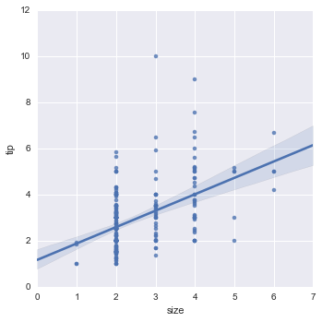
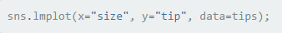
lmplot

Slide 31
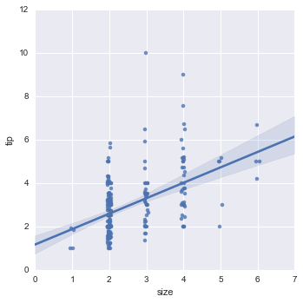
Adding Jitter

Slide 32
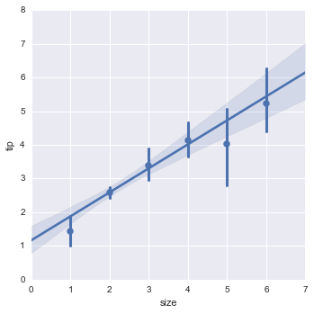
Plot estimator instead of raw points

Slide 33
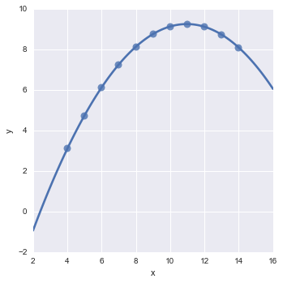
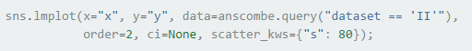
Complex fit models

Slide 34
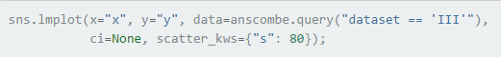
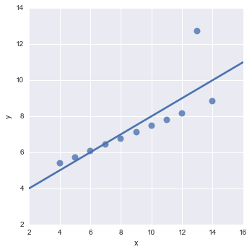
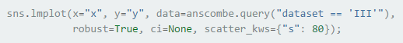
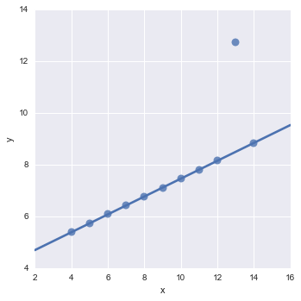

Slide 35
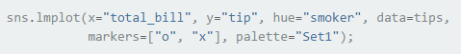

Condition on other variables

Slide 36


Condition As rows and columns

Slide 37
Categorical Plots

Slide 38


FACTORPLOT

Slide 39

Stripplot

Slide 40

Adding Jitter

Slide 41

Swarmplot

Slide 42


Factorplot – 3 categories

Slide 43


Factorplot – Multiple Values

Slide 44


Boxplot

Slide 45


Violinplot
Combines a box plot with KDE

Slide 46


Violinplot

Slide 47


Violinplot with rugs

Slide 48


tsplot – Time Series

Slide 49


Heatmap

Slide 50


Clustermap

Slide 51


Control presentation

Slide 52
BiVariate Distributions

Slide 53


Joint Scatter Plot

Slide 54


Hexbin Plot

Slide 55

KDE

Slide 56


Pair Plot

Slide 57


Pair Plot Variation

Slide 58

Pair plot Variation 2

Slide 59
Data visualization Guidelines

Slide 60
data visualization
Know your audience
Data Scientists
Domain experts
Business People
General Audience
Tell a story
Answer the “So what?” question. Have a specific message
Choose the right visualization
Keep it simple. Less is more

Slide 61

Hans Rosling's 200 Countries, 200 Years, 4 Minutes - The Joy of Stats

Slide 62


Guidelines
Maximize the data-to-ink ratio
Use the 5 seconds rule
Prefer 2D over 3D
Prefer grayscale over color

Slide 63


Slide 64


Slide 65


Slide 66

Visual Variables
Source: Data Points

Slide 67

Color Schemes
Source: Data Points

Slide 68
Poor visualization Examples

Slide 69

Source: Jonathan Cohn via Kenneth Field/Cartonerd

Slide 70


Slide 71


Slide 72


Slide 73


Slide 74


Slide 75


Slide 76


Slide 77


Slide 78


Slide 79


Slide 80


Slide 81


Slide 82


Slide 83
Recommended Resources
https://www.youtube.com/watch?v=GIVK0-SNUgU
Mehrdad Yazdani | Using Exploratory Data Analysis to Discover Patterns
How ANYONE can make insanely better slides https://hackernoon.com/how-anyone-can-make-insanely-better-slides-2398b5c3731c

